Slide 1
Organizational Culture

Slide 2
Chapter Learning Objectives
you should be able to:
Define organizational culture and describe its common characteristics.
Compare the functional and dysfunctional effects of organizational culture on people and the organization.
Identify the factors that create and sustain an organization’s culture.
Show how culture is transmitted to employees.
Demonstrate how an ethical culture can be created.
Describe a positive organizational culture.
Identify characteristics of a spiritual culture.
Show how national culture may affect the way organizational culture is transported to a different country.

Slide 3
National vs Organisational Culture
National Culture | Organisational Culture
Broader More complex Passed from generations Primary and secondary socialisation Difficult to change | Narrower Manageable Secondary socialisation Subcultures Possible to change with time

Slide 4
Organizational Culture
Organizational Culture
A common perception held by the organization’s members; a system of shared meaning
Seven primary characteristics
Innovation and risk taking
Attention to detail
Outcome orientation
People orientation
Team orientation
Aggressiveness
Stability
Notes:
Organizational culture is an important concept in studying how organizations behave. Culture has significant impact on how individuals interpret the impact of their behavior and make decisions about their actions. Culture is defined as a common perception held by the members of the organization or a sense of shared meaning.
Cultures have 7 primary characteristics that define the organization. They are: innovation and risk taking, attention to detail, outcome orientation, people orientation, team orientation, aggressiveness, and stability.

Slide 5
Do Organizations Have Uniform Cultures?
Culture is a descriptive term: it may act as a substitute for formalization
Dominant Culture
Expresses the core values that are shared by a majority of the organization’s members
Subcultures
Mini-cultures within an organization, typically defined by department designations and geographical separation
Core Values
The primary or dominant values that are accepted throughout the organization
Strong Culture
A culture in which the core values are intensely held and widely shared
Notes:
There are several different groupings that most cultures fit into. These groups describe the organization in an effort to help increase the understanding of how an organization works. There are different aspects of culture that need to be defined to help lay a foundation for understanding what culture is.
Dominant culture is the core values that are shared by the majority of employees in the organization.
Subcultures are when there are a variety of different cultures within the organization. These subcultures typically are divided by department and/or geographical separation.
Core values are the primary values that most people in the organization accept.
A strong culture is one in which the core values are intensely held and shared by most.
These definitions are key components of a culture and will help you further understand organizational culture.

Slide 6
What Do Cultures Do?
Culture’s Functions
Defines the boundary between one organization and others
Conveys a sense of identity for its members
Facilitates the generation of commitment to something larger than self-interest
Enhances the stability of the social system
Serves as a sense-making and control mechanism for fitting employees in the organization
Notes:
Cultures take on distinct functions. Some of the things that cultures do are defining the boundary between one organization and others. They also convey a sense of identity for the members of the organization. If the cultures are strong, they can facilitate a continuous commitment to something larger than self-interest over an extended period of time. Cultures also help people know what to expect in the organization and can thereby enhance the stability of the social system. Through doing this, it can also serve as a sense-making and control mechanism for fitting employees into the organization.

Slide 7
Culture as a Liability
Institutionalization
A company can become institutionalized where it is valued for itself and not for the goods and services it provides
Barrier to change
Occurs when culture’s values are not aligned with the values necessary for rapid change
Barrier to diversity
Strong cultures put considerable pressure on employees to conform, which may lead to institutionalized bias
Barrier to acquisitions and mergers
Incompatible cultures can destroy an otherwise successful merger
Notes:
Culture can also be a hindrance to an organization. A company can become institutionalized when people value the organization more than what they provide. When cultures are strong, they can become a barrier to change as their values may not align with the values needed to embrace or facilitate the change. Cultures that may pressure employees to conform can be a barrier to hiring, developing, and promoting a diverse workforce. Finally, if a merger or acquisition occurs, one of the most difficult things to do is to merge the two cultures, causing many mergers to fail.

Slide 8
How Culture Begins
Stems from the actions of the founders:
Founders hire and keep only employees who think and feel the same way they do.
Founders indoctrinate and socialize these employees to their way of thinking and feeling.
The founders’ own behavior acts as a role model that encourages employees to identify with them and thereby internalize their beliefs, values, and assumptions.
Notes:
Cultures start from the very beginning of the organization with the founders. Founders will tend to hire and keep employees who view things in a similar fashion. They will also try to get employees to think about things the way they do and socialize them to their point of view and ways of doing things. This is done so that the founders’ behavior will become the behavior to model after in order to succeed in the organization and to fit in.

Slide 9
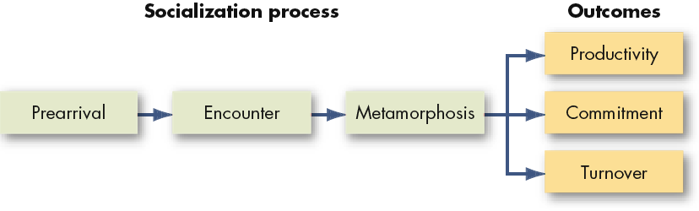
Stages in the Socialisation Process
Pre-arrival
The period of learning prior to a new employee joining the organization
Encounter
When the new employee sees what the organization is really like and confronts the possibility that expectations and reality may diverge
Metamorphosis
When the new employee changes and adjusts to the work, work group, and organization
Notes:
The socialization process involves a few steps. The employee will learn about the organization through literature, interviews, and other people in the prearrival stage. Once the employee starts interacting with other employees, they enter the encounter stage where they see what the organization is really like. In this stage often their expectations are measured against the reality and sometimes they do not align. The third stage is called metamorphosis, when the new employee adjusts to the organization and their work.

Slide 10
Socialisation Programme Options
Choose the appropriate alternatives:
Formal versus Informal
Individual versus Collective
Fixed versus Variable
Serial versus Random
Investiture versus Divestiture
Socialization outcomes:
Higher productivity
Greater commitment
Lower turnover
Notes:
There are a number of possible socialization programs. Each organization needs to select one that best fits their culture. When the socialization process matches an organization’s culture, they have positive outcomes including higher productivity, greater commitment, and lower turnover.

Slide 11
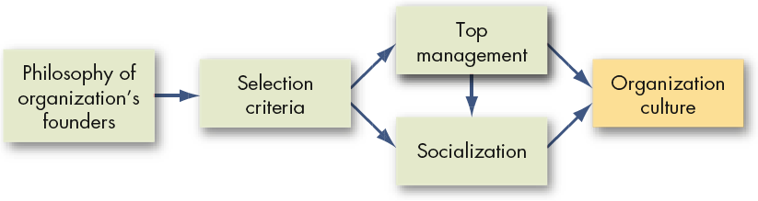
Summary: How Organizational Cultures Form
Organizational cultures are derived from the founder
They are sustained through managerial action
Notes:
Organizational cultures begin with the founder of the organization, continue through the hiring of people who see things similarly, and are enforced through top management and socialization.

Slide 12
How Employees Learn Culture
Stories
Anchor the present into the past and provide explanations and legitimacy for current practices
Rituals
Repetitive sequences of activities that express and reinforce the key values of the organization
Material Symbols
Acceptable attire, office size, opulence of the office furnishings, and executive perks that convey to employees who is important in the organization
Language
Jargon and special ways of expressing one’s self to indicate membership in the organization
Notes:
Employees learn the organizational culture through a number of avenues. They can gain an understanding of culture by hearing stories that present the past and provide explanations for current practices. Rituals, or repetitive sequences of activities, can reinforce the key values of the organization and provide insight into the culture. Material symbols such as dress codes, formal or informal, office size or style, and perks for key employees can denote who is important in an organization.
Language is another way to learn about organizational culture as employees will express themselves in certain ways to indicate membership in the organization.

Slide 13
Power Distance Index
High: There is acceptance that there are justification and
reasons for inequalities of distribution of power
PDI
Low: There is demand for justification and reasons for
inequalities of distribution of power
Individualism v Collectivism Index
There is preference towards personal needs and foals
IDV
Importance given to shared goals and needs of the group
Task Orientation v Person Orientation
Preference towards achievement, material rewards, assertiveness for success
MAS
Importance to wards quality of life, love, care and cooperation over materialistic success
Uncertainty Avoidance
High: Comfort in tried and tested methods with greater intolerance towards unknown and untested methods
UAI
Low: More relaxed attitude towards ways the tasks are
carried out and changes
Long Term Orientation v Short Term Orientation
Pragmatic approach with importance to the future good
and practice thrift and perseverance of values
LTO
Normative with maintaining conventional and time
honoured traditions.
Indulgence v Restraint
There is greater display of natural human drives and gratifications
IND
Tendency to suppress display of gratification,
sometimes due to strict social norms

Slide 14
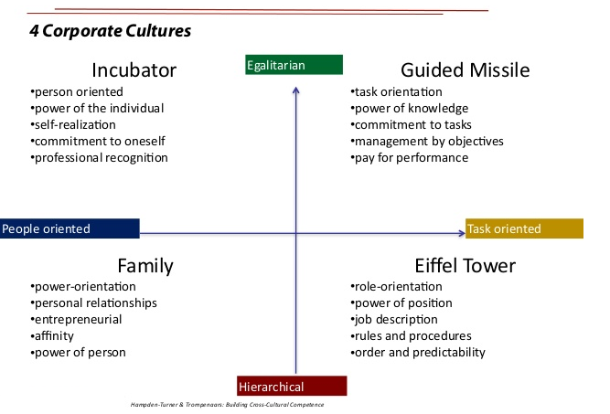
Trompenaars' model of Organisational culture

Slide 15
Creating an Ethical Organizational Culture
Characteristics of Organizations that Develop High Ethical Standards
High tolerance for risk
Low to moderate in aggressiveness
Focus on means as well as outcomes
Managerial Practices Promoting an Ethical Culture
Being a visible role model
Communicating ethical expectations
Providing ethical training
Rewarding ethical acts and punishing unethical ones
Providing protective mechanisms
Notes:
As cultures are created, it is important to incorporate ethics into the cultural norms from the very beginning. Certain characteristics will help develop high ethical standards, such as a high tolerance for risk, so people are not afraid to make mistakes; low to moderate in aggressiveness so that unethical behaviors are avoided and a focusing on the means as well as the outcomes so that ethics is embedded in both.

Slide 16
Creating a Positive Organizational Culture
Positive Organizational Culture
A culture that:
Builds on employee strengths
Focus is on discovering, sharing, and building on the strengths of individual employees
Rewards more than it punishes
Articulating praise and “catching employees doing something right”
Emphasizes individual vitality and growth
Helping employees learn and grow in their jobs and careers
Limits of Positive Culture:
May not work for all organizations or everyone within them
Notes:
A positive organizational culture is one that builds on employee strengths so that employees can develop and grow. It also rewards more than it punishes so employees are not afraid to try new things and feel good about what they are contributing. Finally, it emphasizes individual vitality and growth so that employees are operating at full potential.

Slide 17
Global Implications
Organization cultures, while strong, can’t ignore local culture
Managers should be more culturally sensitive by:
Adjusting speech to cultural norms
Listening more
Avoiding discussions of controversial topics
All global firms (not just U.S. firms) need to be more culturally sensitive
Notes:
Organizational culture still exists within a local culture and that can’t be ignored. It is important that managers increase their ability to become more culturally sensitive through active listening, adjusting communication to the culture in which they are operating, and avoiding controversial topics in their discussions.

Slide 18
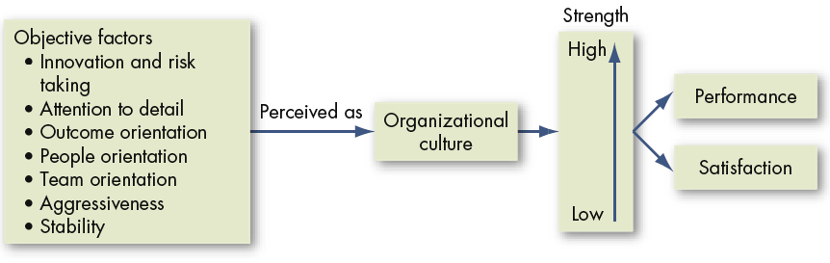
Culture as an Intervening Variable
Employees form an overall subjective perception of the organization based on these objective factors:
The opinions formed affect employee performance and satisfaction.
Notes:
It is important to keep in mind that employees will form a perception of the organization based on things they observe. These opinions will affect their performance and job satisfaction so it is important to pay attention to organizational culture and its impact on employee outcomes.

Slide 19
Summary and Managerial Implications
Strong cultures are difficult for managers to change
In the short run, strong cultures should be considered fixed
Selecting new hires that fit well in the organizational culture is critical for motivation, job satisfaction, commitment, and turnover
Socialization into the corporate culture is important
As a manager, your actions as a role model help create the cultural values of ethics, spirituality, and a positive culture
Notes:
Cultures begin with the founders of the organization and are very difficult to change once they become embedded. In order to maximize employee outcomes, it is important to hire people who fit in the organization and help them become socialized into the corporate culture. Managers can reinforce culture through their actions.

Slide 20

The End

